Slide 1
Minnesota Association of Geriatrics
Inspired Clinicians (MAGIC) Annual Conference 2023
Thursday, November 2, 2023 as a live webinar
Friday, November 3, 2023 in person at Midland Hills Country Club, Roseville, MN

Slide 2
Provided by
Minnesota Association of Geriatrics Inspired Clinicians (MAGIC)
University of Minnesota Medical School, Interprofessional Continuing Education

Slide 3
Learning Objectives
At the conclusion of this course, learners should be able to:
Describe best practice approaches to address brain disorders among older people.
Collaborate effectively across professions to address problems above the knees such as mental health, hearing, communication, swallowing, oral health, foot care and vision problems among older people.
Lead efforts to respond to changes in public policy related to care of older people.
Describe proven approaches to improving quality of care for older people.

Slide 4
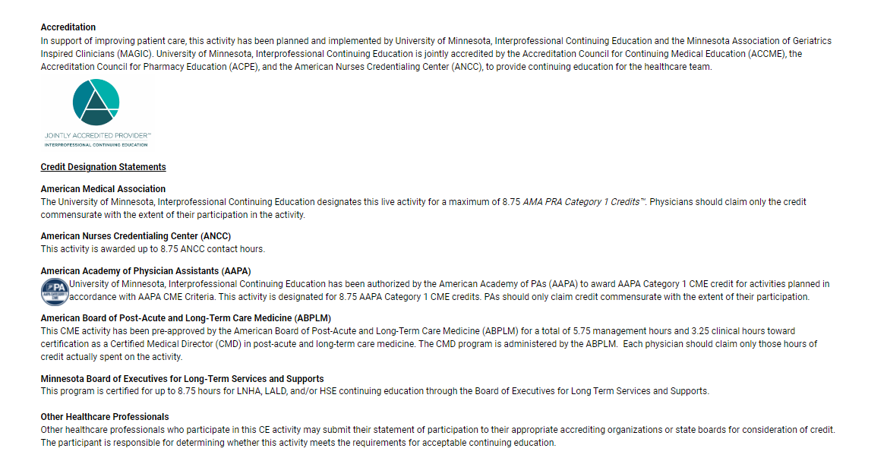

Slide 5
Attendance, CE Credit, and Evaluation
Only those who complete the evaluation will receive a Certificate of Completion.
YOUR ATTENDANCE WILL BE REPORTED TO UMN OCPD BY THE PLANNING TEAM
The Planning Team is using a check-in process for in-person and webinar participants to monitor who has participated in the course. They will provide the University of Minnesota’s Office of Continuing Professional Development with an attendance report.
COMPLETE YOUR ONLINE EVALUATION
You have until November 17, 2023 to complete your online evaluation.
Online Evaluation Access & Certificate of Completion
Visit z.umn.edu/CEPortal to access the CE Portal.
Sign In using the account you created at the time you registered for this course (do NOT create a new account).
Once signed in, click on “My CE” in the top menu.
Select the “Evaluations and Certificates” button and complete your online evaluation.
Once complete, you will be able to access your Certificate of Participation in the same area, and you will receive it via email.

Slide 6
Certified Medical Directors (CMD)
The Certificate of Participation provided to physicians who complete their evaluation by November 17 will include an additional page for individuals who are Certified Medical Directors. The American Board of Post-Acute and Long-Term Care Medicine (ABPLM) has designated the individual sessions of the MAGIC Conference for Management or Clinical Hours. Use the supplemental page to calculate and record the number of hours you earned in each category. Maintain a copy of your Certificate for your personal records.

Slide 7
Disclosure Information
Disclosure of Financial Relationships and Mitigation of Financial Relationships
University of Minnesota Continuing Professional Development adheres to the ACCME’s Standards for Integrity and Independence in Accredited Continuing Education and has policies in place to ensure balance, independence, objectivity and scientific rigor in all of its educational activities. Any individuals in a position to control the content of a CE activity, including faculty, planners, reviewers or others are required to disclose all financial relationships with ineligible entities; individuals who fail to complete the disclosure in advance of the course are not eligible to be involved in this course. Specific disclosure information will be shared with learners prior to the start of the course. All relevant conflicts of interest have been mitigated prior to the commencement of the activity.

Slide 8
Name of individual | Individual's role in activity | Nature of Relationship(s) / Name of Ineligible Company(s)
Edward Ratner, MD | Faculty, Planning Committee Member | Nothing to disclose
Rajean Moone, PhD, LNHA/LALD | Course Director, Faculty | Nothing to disclose
Steven Atkinson, PA, MS | Co-Director, Faculty | Nothing to disclose
Brooke Cunningham, MD, PhD | Faculty | Nothing to disclose
Heidi Holste, Bachelors of Science Political Science | Planning Committee Member | Nothing to disclose
Adam J Suomala, MPA | Faculty | Nothing to disclose
Cathy Lauring, MSN | Faculty | Nothing to disclose
Kari Everson, MSN | Faculty, Nurse Planner | Nothing to disclose
Nikki Siddons, APRN | Faculty, Nurse Planner | Nothing to disclose
Robert F Rode, JD | Faculty | Nothing to disclose
Anita Raymond, MSW, LISW, CMC | Faculty | Nothing to disclose
Dana Urbanski, AuD | Faculty | Nothing to disclose
Stephen Shuman, DDS, MS, FGSA | Faculty | Nothing to disclose
John Brose, PhD, LP, LMFT, LADC | Faculty | Nothing to disclose
Katlin Vass, OD | Faculty | Nothing to disclose
Meghan Michelotti, LCSW, Social Worker, VIST Coordinator | Faculty | Nothing to disclose
Elizabeth N Francis, PharmD | Faculty | Nothing to disclose
Michael B DeBrule, DPM | Faculty | Nothing to disclose
Christine Cornell, B.S. B.A. | Faculty | Nothing to disclose
Amal Said, Other, CNP | Faculty | MISSING
Jackie Yang, NP | Faculty | MISSING
Miguel Ruiz, MD | Faculty | Nothing to disclose
Minerva S Echabu, RN | Faculty | MISSING
Amanda Pojanowski, OD | Faculty | MISSING

Slide 9
Syllabus access
PDFs of presenters’ slides are available online:
Go to z.umn.edu/CEPortal
Sign into your account
Select “My CE” in top menu
Select “Syllabus”
View Syllabus for MAGIC 2023
**Please note, PDFs are only available if the presenters authorized the sharing of their presentation slides

Slide 10
Acknowledgement of Support
This course has not been funded by educational grants or in-kind grants. We are thankful for the participation of our exhibitors and invite you to visit the exhibit hall during breaks.
GOLD LEVEL
Allina Health | Aetna
Associated Clinic of Psychology
Community Senior Care (HealthPartners/Park Nicollet)
Genevive
Lifespark
MHealth Fairview MiMedx Group Inc.
Northern Lights Health, LLC
Twin Cities Physicians

Slide 11
Acknowledgement of Support
This course has not been funded by educational grants or in-kind grants. We are thankful for the participation of our exhibitors and invite you to visit the exhibit hall during breaks.
SILVER LEVEL
Bluestone Physician Services
Minnesota Northstar Geriatrics Workforce Enhancement Program, at the University of Minnesota
Nura Pain Clinics
Lotus Pharmacy
Presbyterian Homes and Services
PointClick Care
Sterling Long Term Care Pharmacy
Thrifty White Pharmacy
UMN, Center for Health Aging and Innovation

Slide 12
Acknowledgement of Support
This course has not been funded by educational grants or in-kind grants. We are thankful for the participation of our exhibitors and invite you to visit the exhibit hall during breaks.
BRONZE LEVEL
Apex Medical
Benedictine
Care Providers of Minnesota
Compassion & Choices
GeneSight – Myriad Genetics
Genevive
Guardian Pharmacy Minnesota
LeadingAge Minnesota
Neurocrine Biosciences
Nura Pain Clinics Edina/Coon Rapids
Pfizer
Lanyards provided by Mary T. Inc. Housing and Healthcare Beverage Station Provided by Acadia Pharmaceuticals

Slide 13
Questions?
Email cme@umn.edu if you have credit-related questions or need assistance with the CE Portal.
Email info@minnesotageriatrics.org if you have questions about the content and/or faculty or questions about MAGIC membership.

